Slide 1
An Introduction to
Reinforcement Learning
By Christopher Torrington

Slide 2
Talk about training dogs

Slide 3
Not doing GPI – doing eval & iteration separately. No Dynamic programming

Slide 4
Markov Decision Process

Slide 5
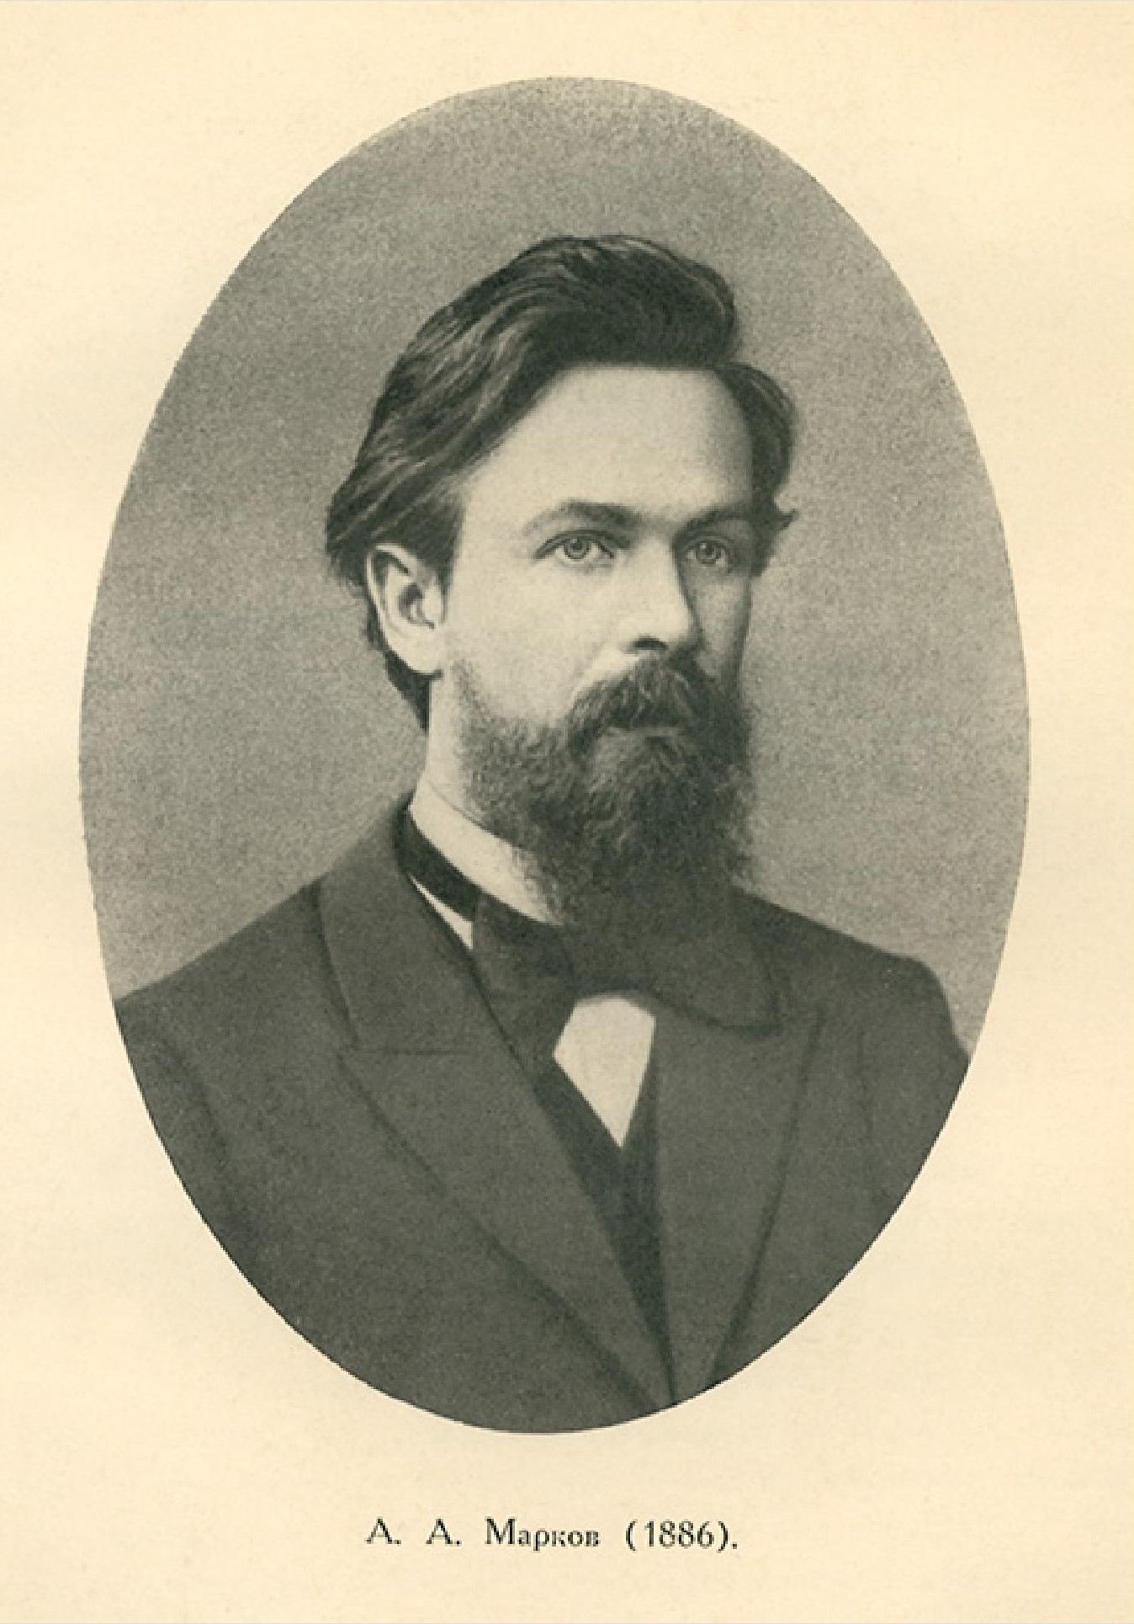
Andrey Markov
Notes:
The name of MDPs comes from the Russian mathematician Andrey Markov as they are an extension of Markov chains.

Slide 6
Main
Space
Reward
+
0.5
Academy Room
1
No reward
0
Outside
- reward

